Slide 1
Algorithm Analysis

Slide 2
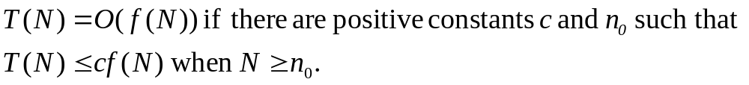
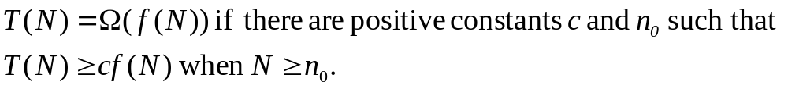
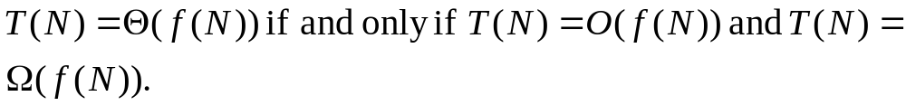
Mathematical Background

Slide 3
Explanation with growth rate
The growth rate of T(N) is less than or equal to that of f(N).
The growth rate of T(N) is greater than or equal to that of f(N).
The growth rate of T(N) equals the growth rate of f(N).
The growth rate of T(N) is less than that of f(N).

Slide 4
When T(N) = O(f(N)), f(N) is an upper bound on T(N) and T(N) is a lower bound on f(N).

Slide 5
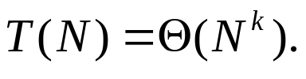
General Rules
Rule 1:
If T(N) = O(f(N)) and U(N) = O(g(N)), then
(a) T(N) + U(N) = max(O(f(N)), O(g(N))),
(b) T(N)*U(N) = O(f(N)*g(N)).
Rule 2:
If T(N) is a polynomial of degree k, then

Slide 6
General Rules
Rule 3:

Slide 7


Notes
Do not include constants or low-order terms inside a Big-Oh.
The relative growth rates of two function f(N) and g(N):
if the limit is 0, f(N) = o(g(N));
if the limit is c, f(N) = theta(g(N));
if the limit is g(N) = o(f(N));
if the limit oscillates, no relation exists.

Slide 8
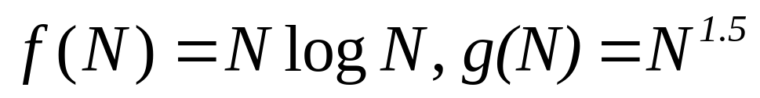
Example

Slide 9
Analysis Model
It takes exactly one time unit to do any calculation such as addition, multiplication, assignment, comparison, etc.
There is infinite amount of memory.
It doesn’t include extra cost of doing I/O
It doesn’t consider the cost associated with paging, swapping, etc.

Slide 10
What to Analyze
No Compiler, architecture, system configuration, etc.
Algorithm, and scale of the algorithm.

Slide 11
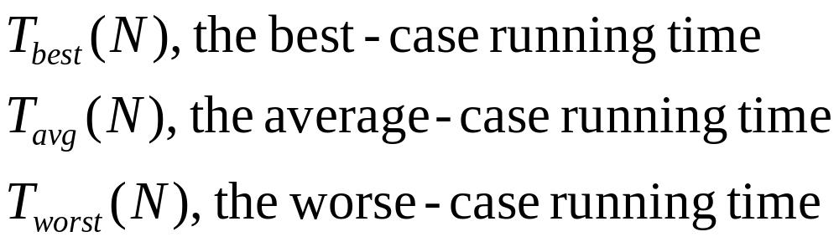

Slide 12
Running Time Calculations
Throw away leading constants
Throw away low-order terms
Computing a Big-Oh, an upper bound for running time: the program may end earlier, but never later

Slide 13
Running Time Calculations
int sum(int n)
{
int partialSum;
partialSum = 0; /* 1 */
for (int i=0; i <= n-1; i++) /*2*/
partialSum += i*i*i; /* 3 */
return partialSum; /* 4 */
}

Slide 14
Running Time Calculations
Line 1 and 4: one unit each
Line 3: 4N
Line 2: 1+(N+1)+N=2N+2
Total: 6N+4 => O(N)

Slide 15
General Rules for Big-Oh
“for” loop: The running time for a “for” loop is at most the running time of the statements inside the “for” loop (including tests) times the number of iterations.
Nested loop: the total running time of a statement inside a group of nested loop is the running time of the statement multiplied by the product of the sizes of all the loops.

Slide 16
General Rules for Big-Oh
For consecutive statements: add them up
IF/ELSE: the running time of an if/else statement is never more than that of the test plus the larger of the running times of S1 and S2.

Slide 17
Example
long fib(int n)
{
/*1*/ if (n<=1)
/*2*/ return 1;
else
/*3*/ return fib(n-1)+fib(n-2);
}

Slide 18
Example
T(N) = T(N-1) + T(N-2) + 2 (one test and one addition) => T(N) >= fib(n) (by induction)
By induction, we can prove that
Thus, the running time grows expotentially

Slide 19
Solutions for the Maximum Subsequence Sum Problem
int maxSubSum1(const vector<int> &a)
{
/*1*/ int maxSum = 0;
/*2*/ for (int i = 0; i < a.size(); i++)
/*3*/ for (int j=i; j < a.size(); j++)
{
/*4*/ int thisSum = 0;
/*5*/ for(int k=i;k<=j;k++)
/*6*/ thisSum+=a[k];
/*7*/ if(thisSum>maxSum)
/*8*/ maxSum = thisSum;
}
/*9*/ return maxSum;
}

Slide 20
The loop at line 2 is of size N
The second loop has size N – i => N (worst case)
The third loop has size j – i +1 => N (worse case).
Line 6: 1
Total O(1*N*N*N) = O(N³)

Slide 21
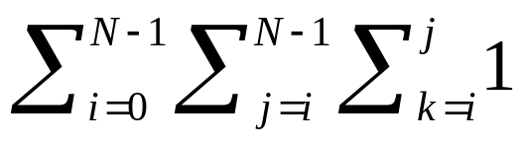
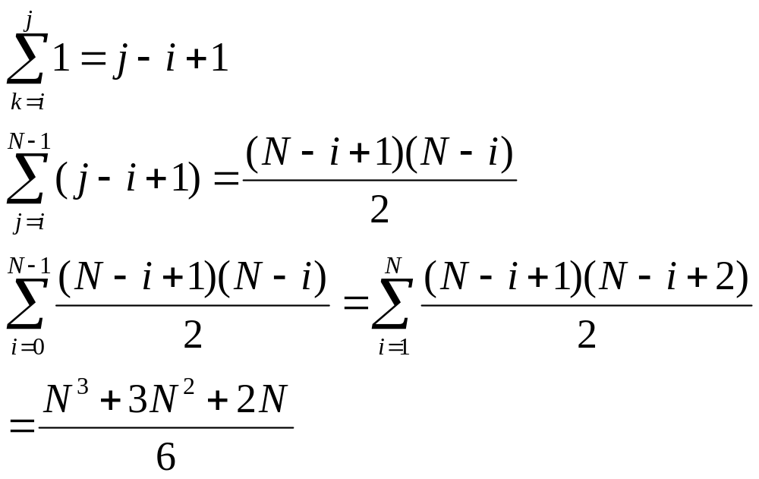

Slide 22
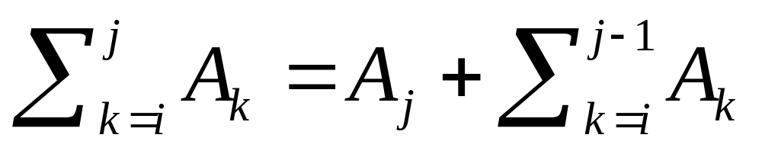

Slide 23
The second solution
int maxSubSum2(const vector<int> &a)
{
/*1*/ int maxSum = 0;
/*2*/ for (int i = 0; i < a.size(); i++) {
/*3*/ int thisSum = 0;
/*4*/ for (int j=i; j < a.size(); j++)
{
/*5*/ thisSum += a[j];
/*6*/ if(thisSum > maxSum)
/*7*/ maxSum = thisSum;
}
}
/*8*/ return maxSum;
}

Slide 24
The third solution
Recursive function
Divide-and-conquer strategy
O(NlogN)

Slide 25
Divide-and-conquer
Split the problem into two equal subproblems
Solve the subproblems recursively
Patch together the two solutions of the subproblems, possibly doing a small amount of additional work, to arrive at a solution for the whole problem

Slide 26
Where can the maximum subsequence sum be?
The left half of the input (solving recursively)
The right half of the input (solving recursively)
Across the middle and in both halves: finding the largest sum in the first half that including the last element in the first half, and the largest sum in the second half that includes the first element in the second half. Then add the two sums together.

Slide 27
Example
--------------------------------------------------
first half | second half
---------------------------------------------------
4 -3 5 -2 -1 2 6 -2
Max in the 1st half: 6 (1 through 3)
Max in the 2nd half: 8(6 through 7)
Max: 4 (1 through 4)
Max: 7 (5 through 7)
Sum of two subtotal: 11 (1 through7)

Slide 28
The third solution
Line 1 to 4: the base case => constant
Line 8 to 12 and 13 to 17: compute the two maximum sums that touch the center divider => O(N)
Line 6 and 7: 2T(N/2)
Total: 2T(N/2) + O(N)

Slide 29
T(N)=2T(N/2) + N
T(1) = 1
T(2) = 4 = 2*2
T(4) = 12 = 4*3
T(8) = 32 = 8*4
T(16) = 80 = 16*5
For N = 2^{k}, T(N) = N*(k+1) = NlogN +N = O(NlogN)

Slide 30
The fourth solution
int maxSubSum4(const vector<int> &a)
{
/*1*/ int maxSum = 0, thisSum = 0;
/*2*/ for (int i = 0; i < a.size(); i++) {
{
/*3*/ thisSum += a[j];
/*4*/ if(thisSum > maxSum)
/*5*/ maxSum = thisSum;
/*6*/ else if (thisSum < 0)
/*7*/ thisSum = 0;
}
/*8*/ return maxSum;
}

Slide 31
Logarithms in the running time
An algorithm is O(logN) if it takes constant (O(1)) time to cut the problem size by a fraction (e.g., ½)
An algorithm is O(N) if constant time is required to merely reduce the problem by a constant amount (e.g., by 1)

Slide 32
Binary Search (A,X)
template <class Comparable>
Int binarySearch(const vector<Comparable> &a, const Comparable &x)
{
/*1*/ int low = 0, high = a.size()-1;
/*2*/ while (low <= high)
{
/*3*/ int mid = (low + high) / 2;
/*4*/ if (a[mid] < x)
/*5*/ low = mid + 1;
/*6*/ else if (x < a[mid])
/*7*/ high = mid - 1;
else
/*8*/ return mid; // found
}
/*9*/ return NOT_FOUND
}

Slide 33
Euclid’s algorithm for greatest common divisor
long gcd(long m, long n) // assuming m>=n
{
/*1*/ while (n!=0)
{
/*2*/ long rem = m%n;
/*3*/ m = n;
/*4*/ n = rem;
}
/*5*/ return m;
}

Slide 34
Theorem: if M > N, then M mod N < M/2
Proof:
There are two cases. If N <= M/2, the since the remainder is smaller than N, it is true for this case. If N > M/2, N goes into M once with a remainder M – N < M – M/2 < M/2, again, true

Slide 35
Raising an integer to a power
long pow(long x, int n)
{
/*1*/ if (n==0)
/*2*/ return 1;
/*3*/ if (n==1)
/*4*/ return x;
/*5*/ if (isEven(n))
/*6*/ return pow(x*x, n/2);
else
/*7*/ return pow(x*x, n/2)*x;
}

